Slide 1

CSE 464 : Software Quality Assurance and Testing
Perspective on Software Testing
Janaka Balasooriya

Slide 2
From the Last Lecture
What is software quality?
  Different stakeholders have different view points about the quality
  Various software quality frameworks such as ISO 9126, CMM and McCall’s triangle of quality have being proposed
Quality Assurance
  In general, quality assurance can be enforced at three different levels (defect prevention, defect removal, and defect containment)
Software testing (What do we test?)
  Software testing is the widely practiced quality assurance activity. It comes under defect reduction.
Course syllabus and outcomes
Course assessment and grading
Reading Assignment

Slide 3
Todays Agenda
What is software testing? : Insight from a Venn Diagram
Software Testing: Different Approaches

Slide 4
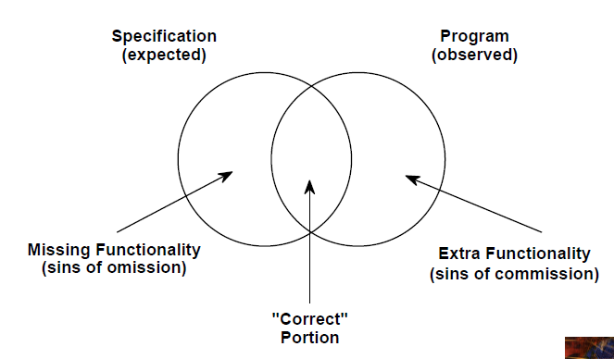
What do we test? : Insights from a Venn diagram
SRS document gives the specification (expected functionality) of the software
Actual program has the functionality implemented

Slide 5
Observing Program Behavior Including Tested Behaviors

Slide 6
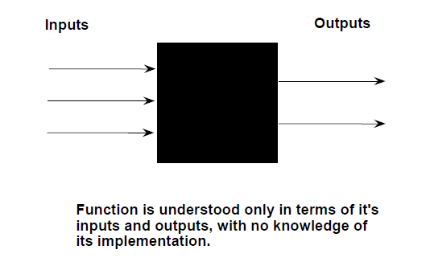
Functional Testing
Functional Testing (Black Box)

Slide 7
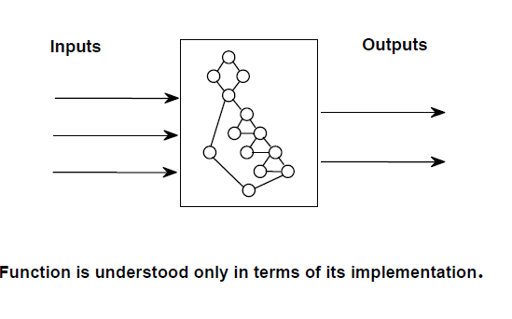
Structural Testing
Structural Testing (White Box)

Slide 8
Functional vs. Structural Testing
They are two fundamentally different approaches in designing test cases.
Functional testing uses the specification while structural approach uses the program in designing test cases.
So, both approaches are needed in determining if we are building the right product and building product right

Slide 9
Are Functional and Structural Testing Enough?
Class Discussion

Slide 10
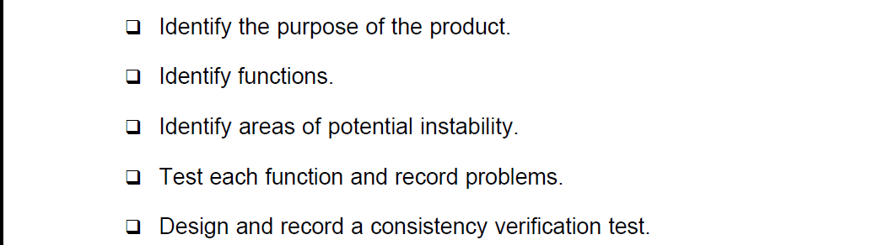
Exploratory Testing
What is exploratory testing?
  Is a blackbox testing approach where, a tester first study the software system to understand its purpose (intended usage, users, execution environments, social impact …etc) and test functionalities of the software by grouping them based in importance, similarity …etc.
Exploratory Testing Steps
http://www.satisfice.com/tools/procedure.pdf

Slide 11
Observing Program Behavior Including Tested Behaviors

Slide 12
Various Approaches to Software Testing
Software Testing
Static Testing
Dynamic Testing
Reviews
Inspections
Walkthroughs
Functional (black box)
Structural
(white box)
Code coverage
Data Path
Slicing
Specification based
Exploratory
Boundary value analysis
Equivalent classes
Decision table
Cause and effect
Model-based testing

